Slide 1

Analysis Studies for GSI2021 campaign
7/09/2022
Giacomo Ubaldi

Slide 2
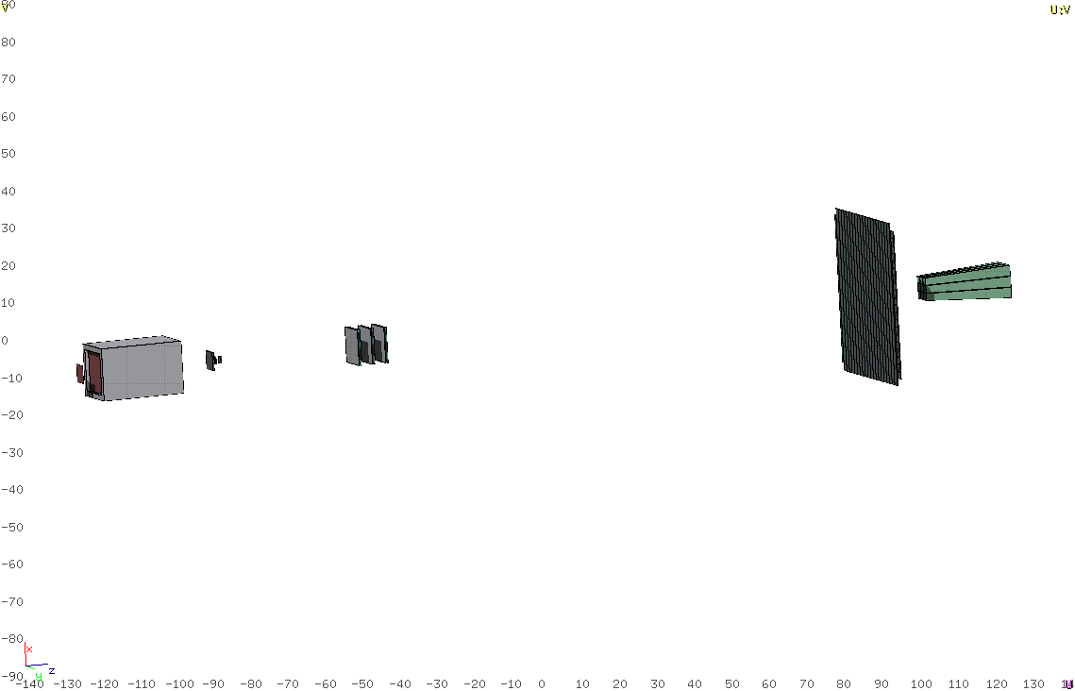
Goal
Analysis of data taken at GSI in 2021 of ¹⁶O 400 MeV/u and 200 MeV/u against C as target
Analysis integrated in SHOE and optimization for specific data
TW
BM
MSD
SC
VTX
CALO
TG
Specific goal:
Elemental fragmentation cross section
Angular differential cross section

Slide 3
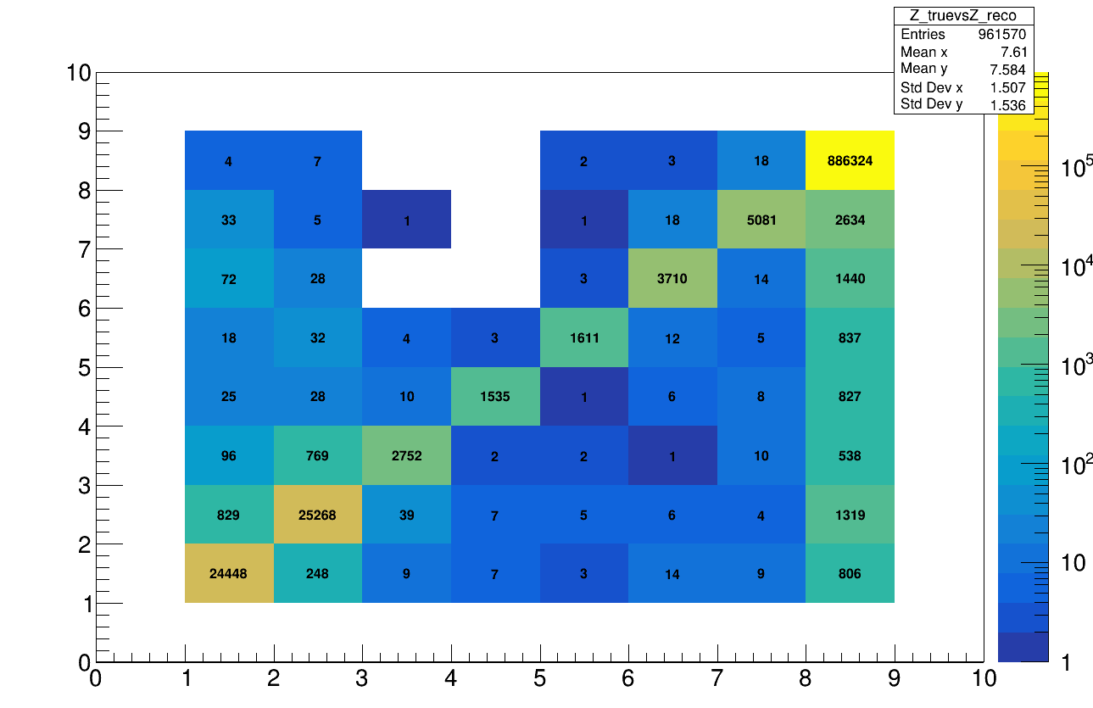
Reconstruction
Starting with MC data reconstructing fragment charge
Study of the MC tracks reconstructed by tracking algo
  Migration Matrix diagonal + misreconstruction
Z_{reco}
Global mis-reconstruction around 1%
Main contribution of misreconstructed charge
for Z=8 and Z=1,2 → where the statistics is high
Z_{true}

Slide 4
Reconstruction, cuts
TW
BM
MSD
SC
VTX
CALO
TG
Cuts can be applied in order to make the migrant matrix more diagonal
Let’s inspect how charge is reconstructed in TW

Slide 5
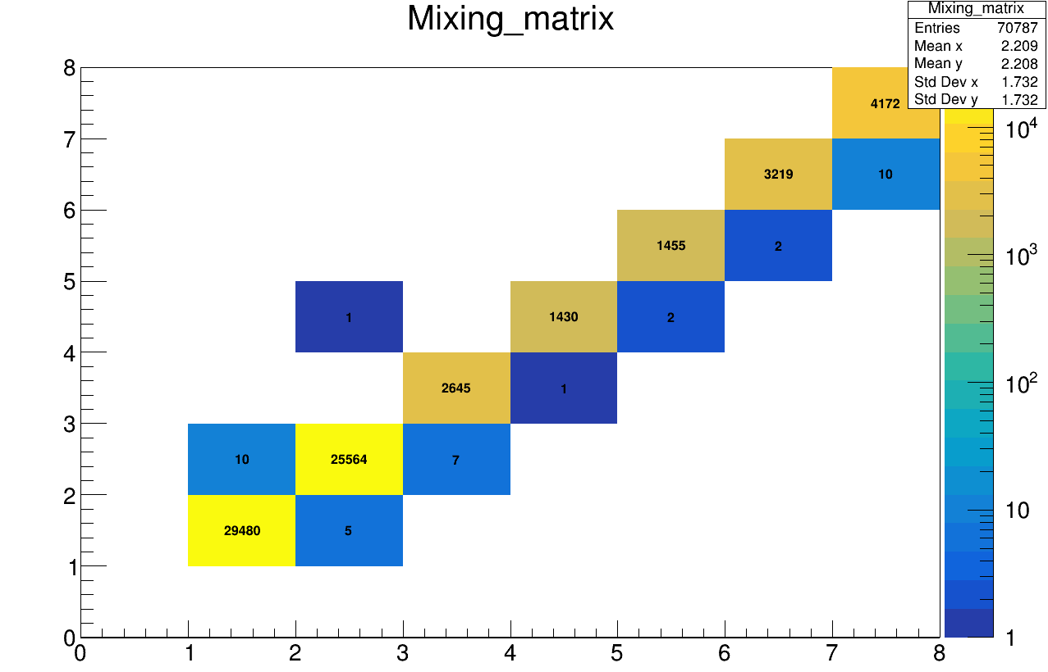
Reconstruction, TW Algo
Let’s study the MC particle, directly generated by the simulation
MC particles generated in TARGET which arrives after the TW → what can be detected by my apparatus
Z_{MC} vs Z_{TW-ALGO}
Z_{TW}
Much more diagonal
TW algo systematic is not the main problem
Z_{true}

Slide 6
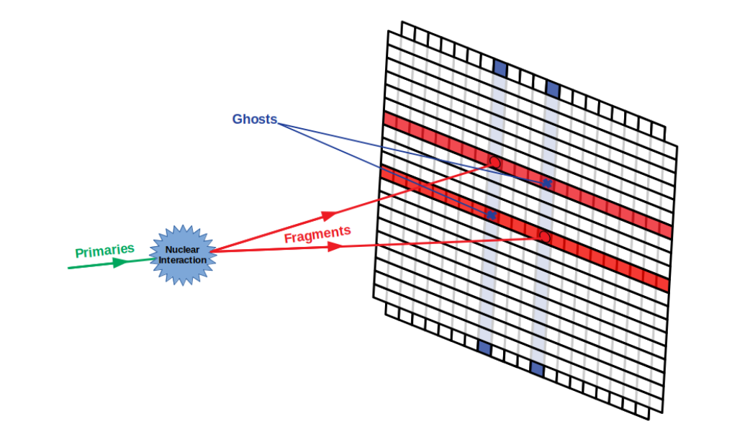
Reconstruction, Track Algo
One source of systematics could be the presence of Pile up / Ghost hits in the TW point of the track
twp→GetMcTracksN() > 1 :
The object TATWPoint is the superimposition
of the Hit_{x} and Hit_{y} on the rispective bars
It is possible that every bar is hitted with more than
a particle at the same time:
  Pile up
  Ghost hits
The reconstructed charge is then wrong because of
a wrong hits input
→ remove them asking GetMcTracksN() == 1

Slide 7
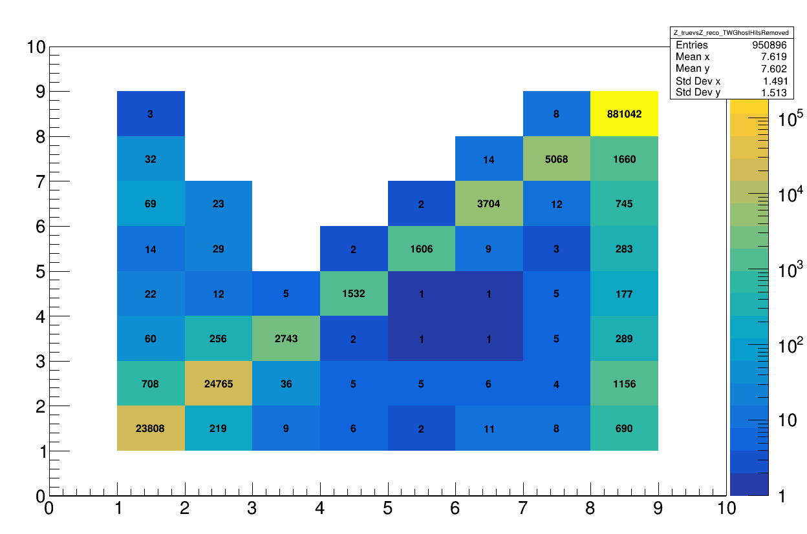
Reconstruction, Track Algo
Applying the TW Ghost Hits cut:
Z_{reco}
Z_{reco}
After cut:
Z_{true}
Z_{true}
Es Z=6
Mis-reconstructed: 30% (27% from Oxygen)
Mis-reconstructed: 19% (16% from Oxygen)
TW ghost impact to be considered as a systematics/bkg

Slide 8

Reconstruction
TW ghost impact to be considered as a systematics/bkg

Slide 9
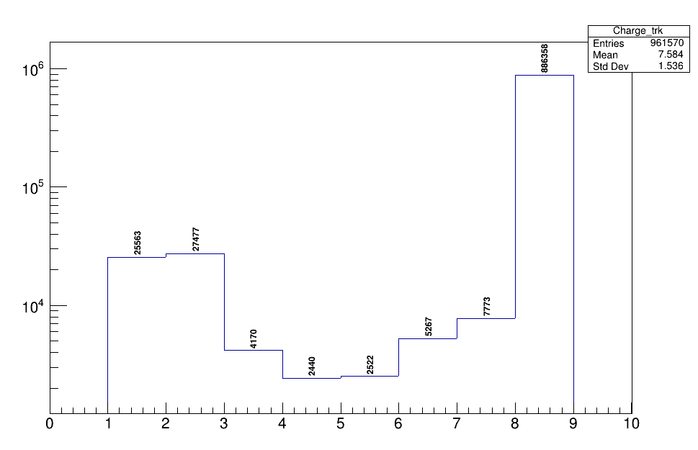
Reconstruction, Yield
Y(Z)
Z_{reco}
TW ghost impact to be considered as a systematics/bkg

Slide 10
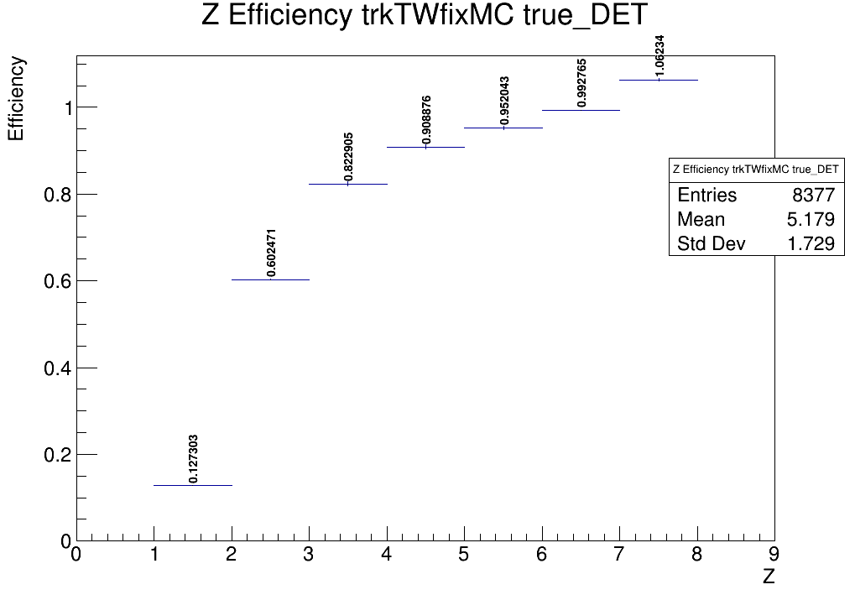
Reconstruction, efficiency
Reconstruction efficiency
reco tracks / simulated particles

Slide 11
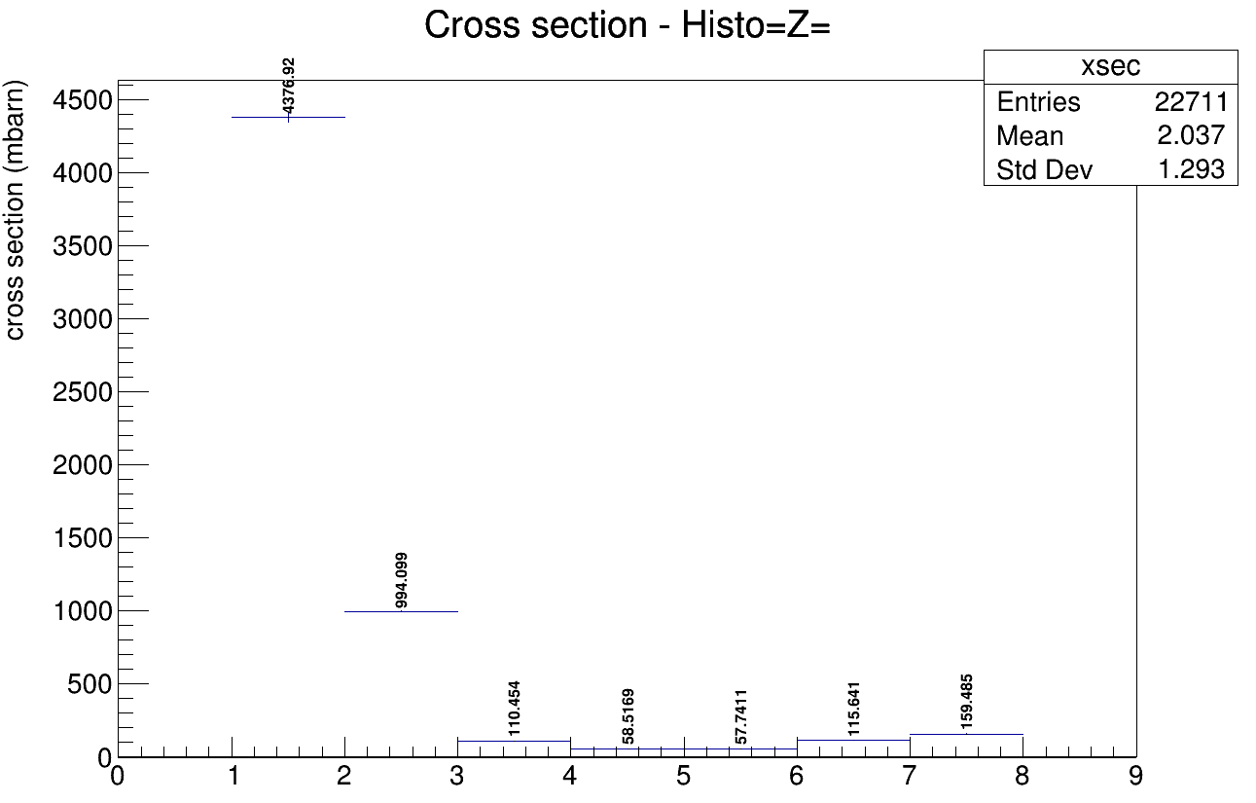
Elemental frag. cross section
Values of Z=1,2 depends
on the cut MC (es. angular acceptance)
Z

Slide 12
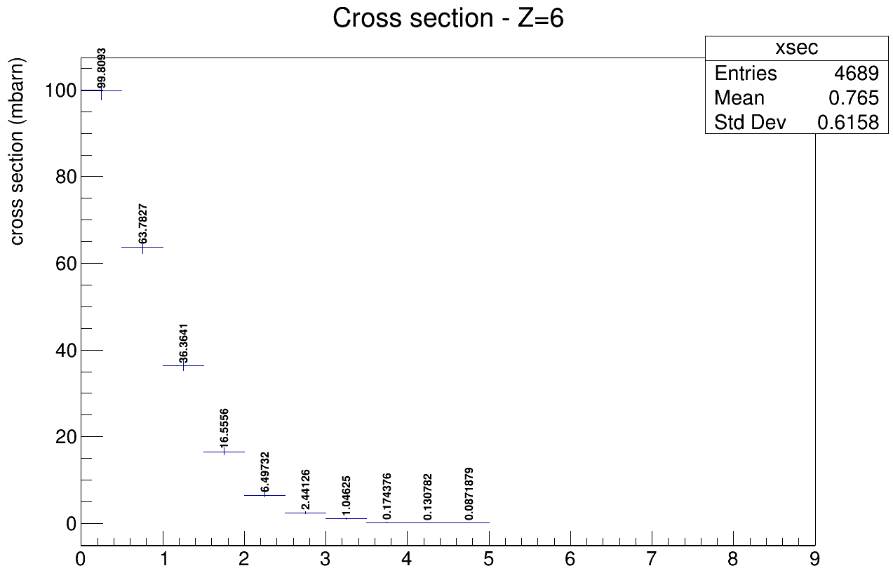
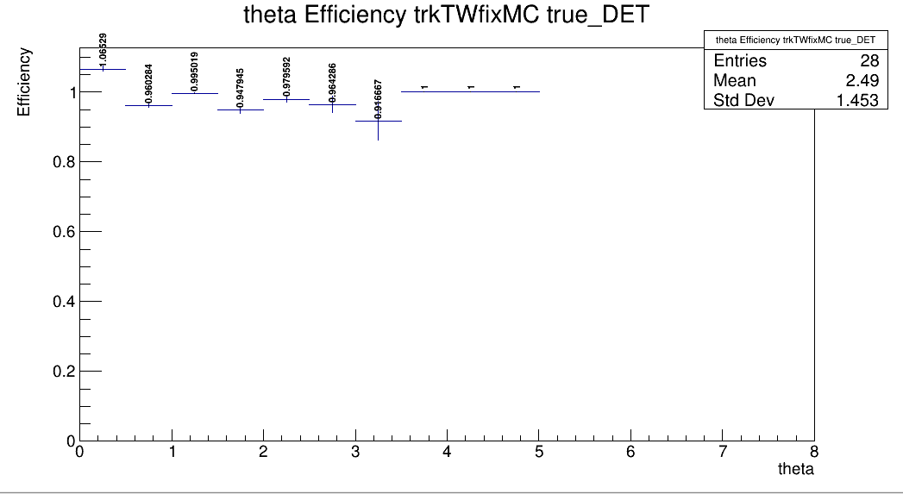
Angular differential cross section
Es Z=6
mbarn / degree°
Track efficiency
Theta (°)

Slide 13
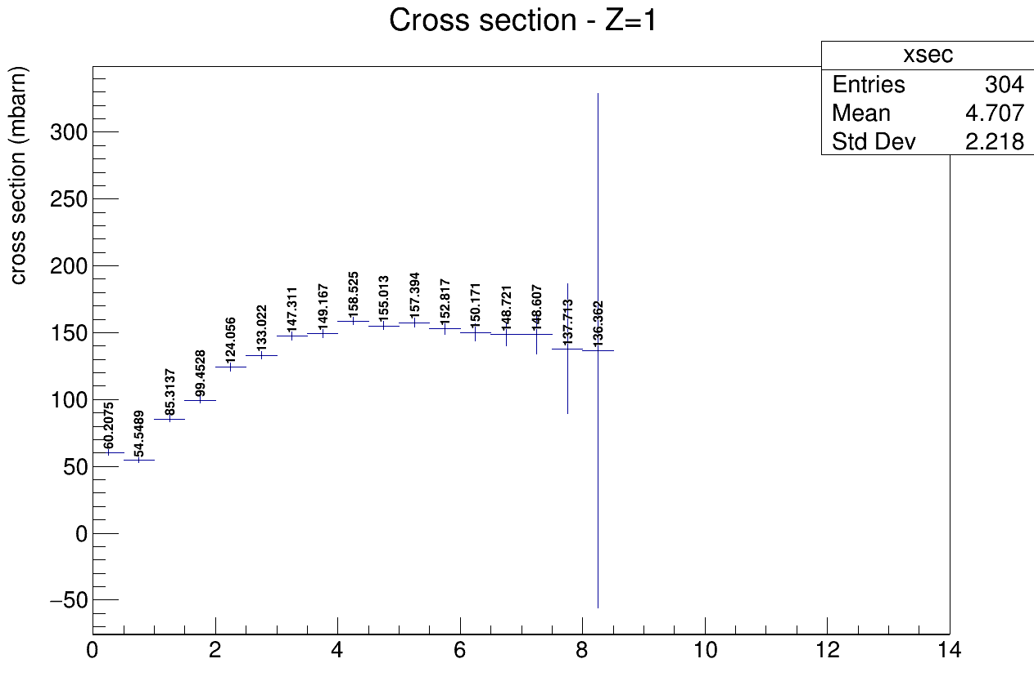
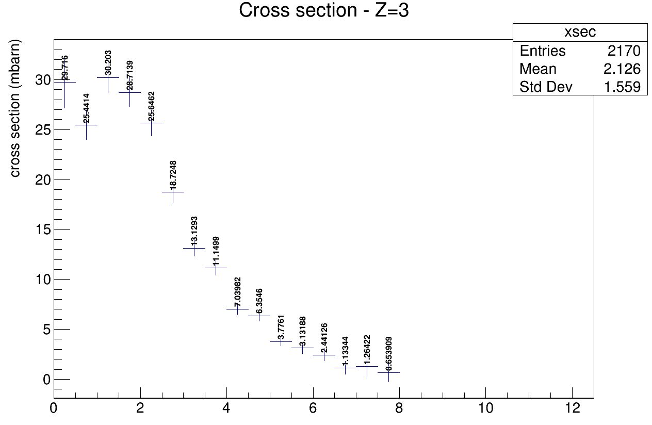
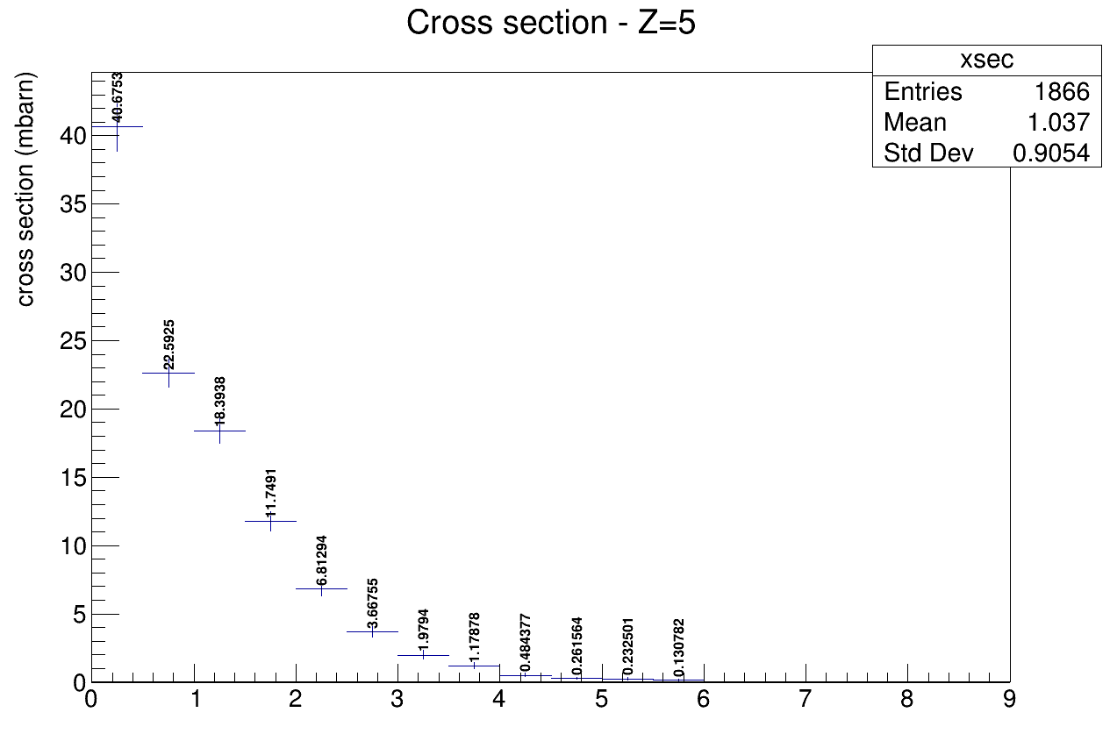
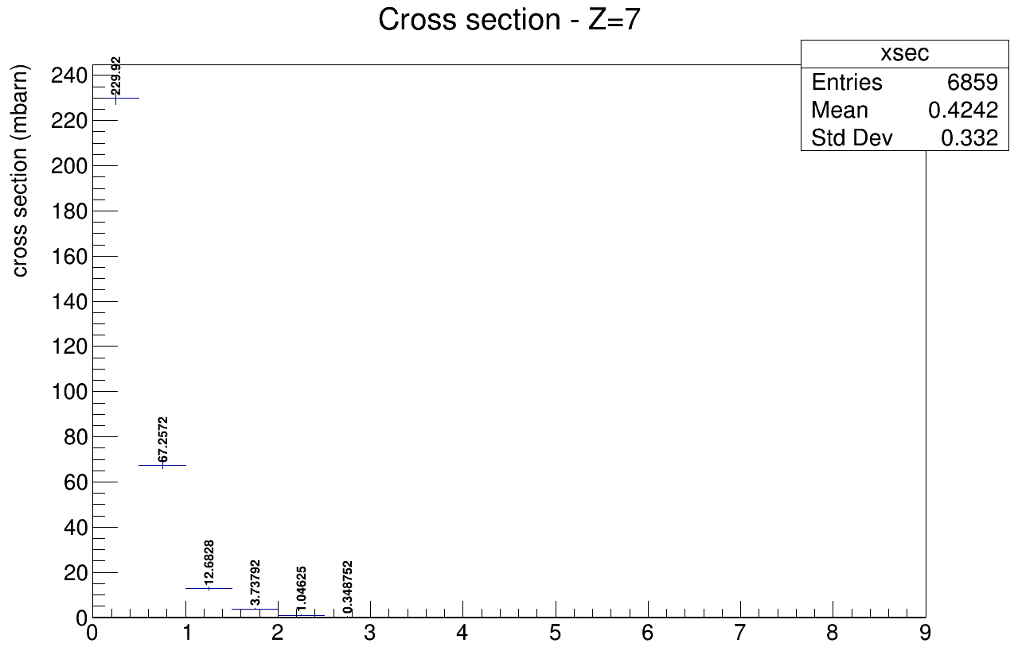
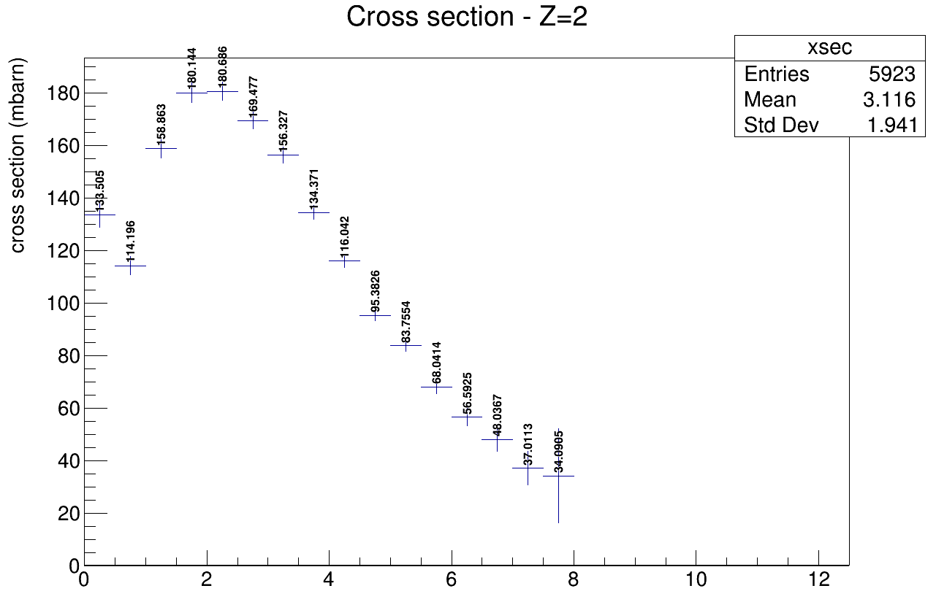
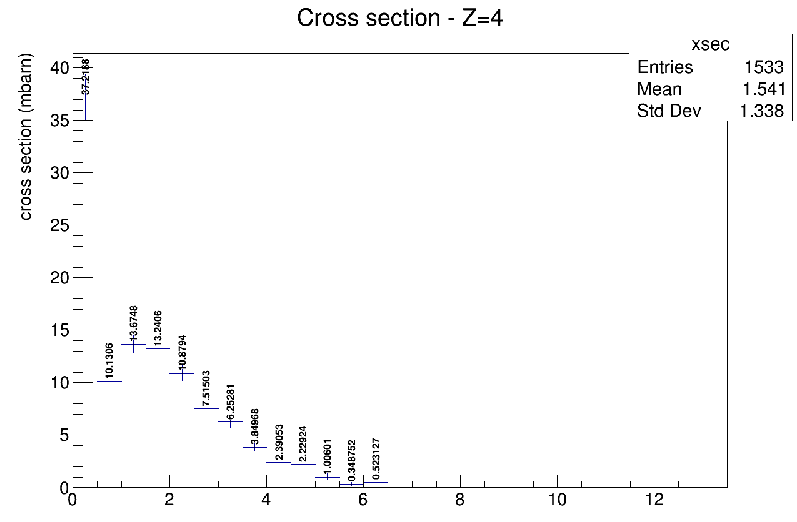
Angular differential cross section

Slide 14
Conclusions
First preliminary results based on MC events with a reasonable order of magnitude
To do:
Study of further efficiency and systematics due to TW and Track algorithm
Background to be considered: es fragmentation after target
Need to study triggered data
Apply cross section “recipe” to real data

